Slide 1
Ethics Committee Approval Letter Review Points
Presented by - : Aarti Yadgire

Slide 2
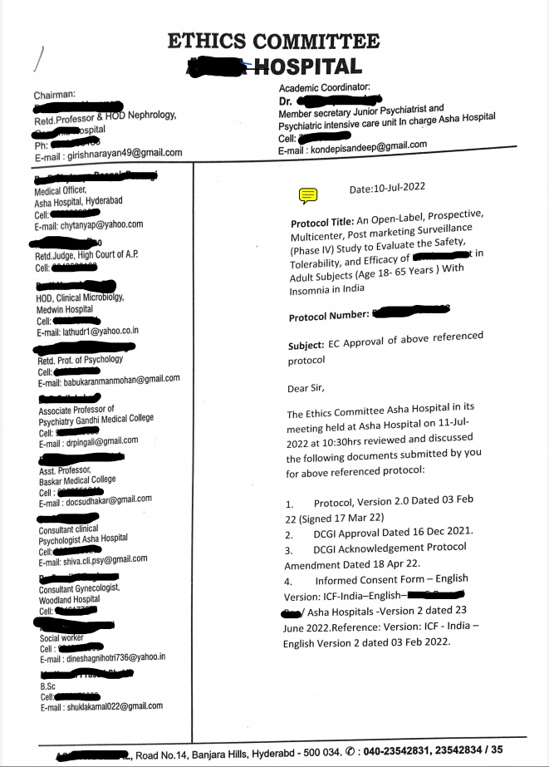

Name of EC (Study code / protocol No)
Date and Time
Documents reviewed with version No. and date

Slide 3
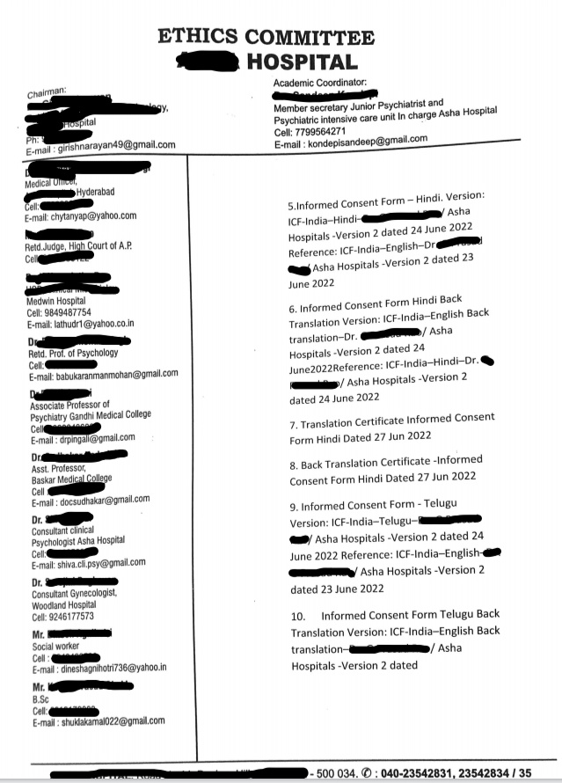
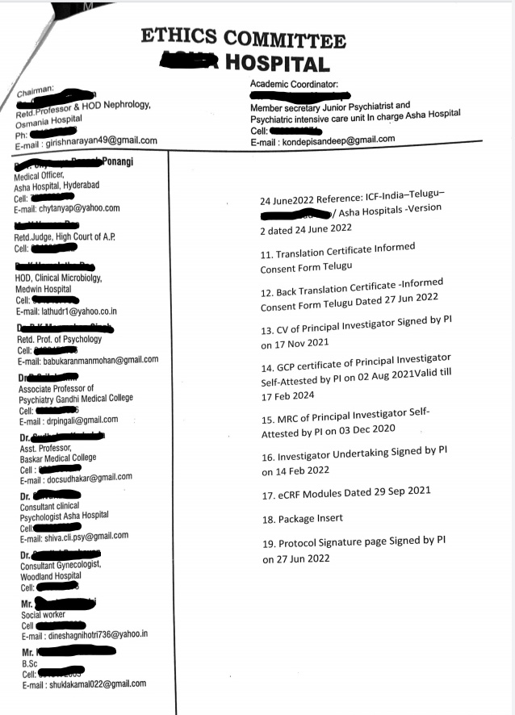

Slide 4
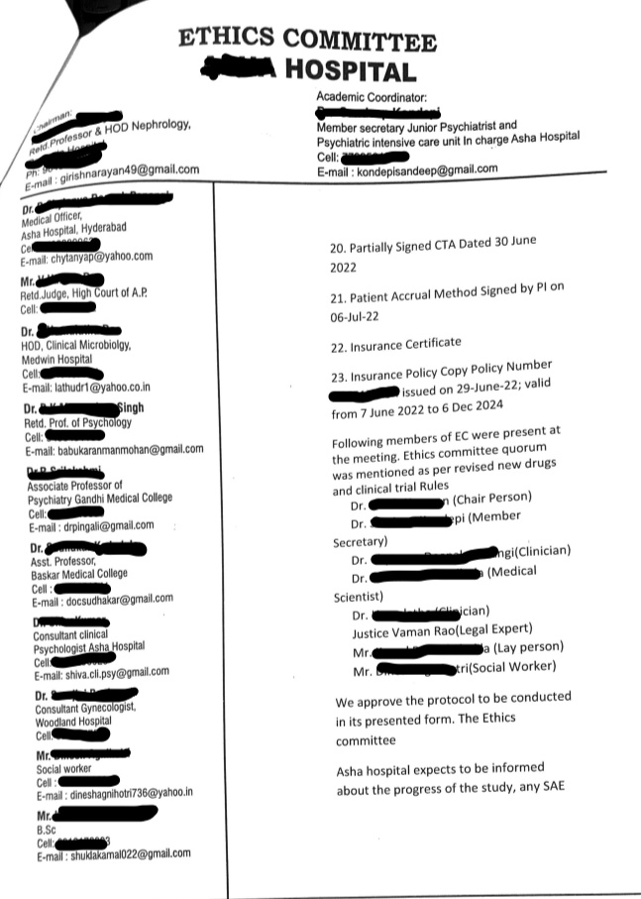
Name of EC Member present
Qualification of EC Members

Slide 5
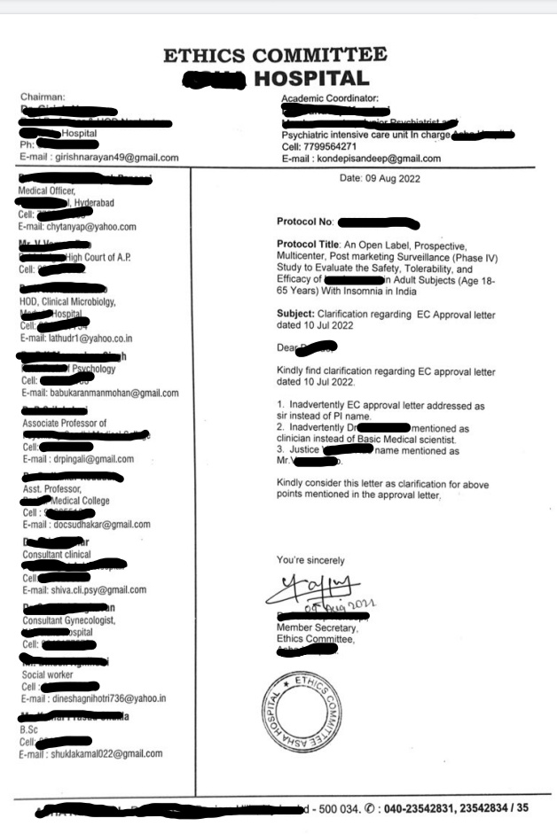

Signature of secretory or authorized signatories with dated

Slide 6
Clarification reagarding EC approval letter

Slide 7
Other points :-
Affiliations of EC Members
Expert commitee or specialist details and confermation about voting
Confermation about conflict of interest
Confermation about PI and study teams non participation
Duration of approval mentioned

Slide 8
Thank you

